Slide 1
Data Visualization & Sharing
Hobby, Martin ` Week 1 – Day 4

Slide 2
Goals
Understand why visualization matters
Learn basic graph types
Use Python to plot data
Explore platforms for sharing datasets
Discuss ethics

Slide 3
Why Visualize Data?
Spot patterns and trends
Communicate findings clearly
Debug issues with sensors
💡 Visualization may help in making decisions on how to prepare the data for machine learning

Slide 4
Basic graph types

Slide 5
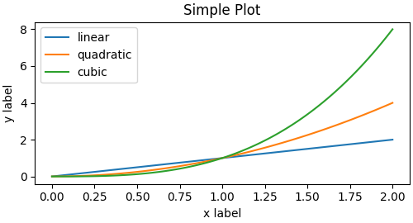
Line Graphs
Best for showing trends over time for example;
Temperature readings every hour
Soil moisture across days
plt.plot(time, temperature, color=‘a’)

Slide 6
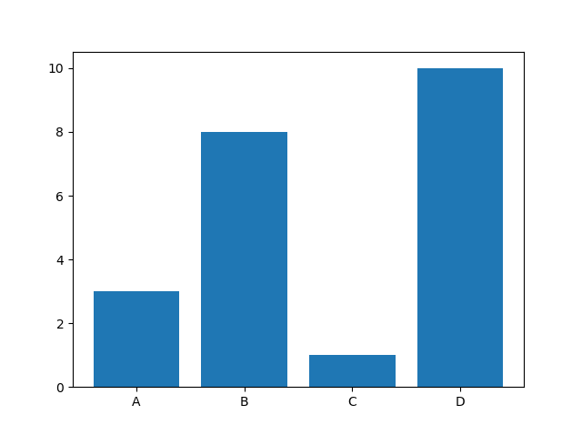
Bar Graphs
Best for comparing categories or totals;
Average humidity per day
CO₂ levels across rooms
plt.bar(regions, rainfall)

Slide 7
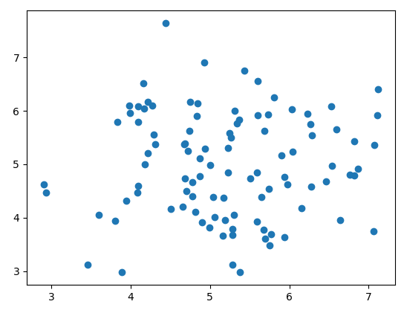
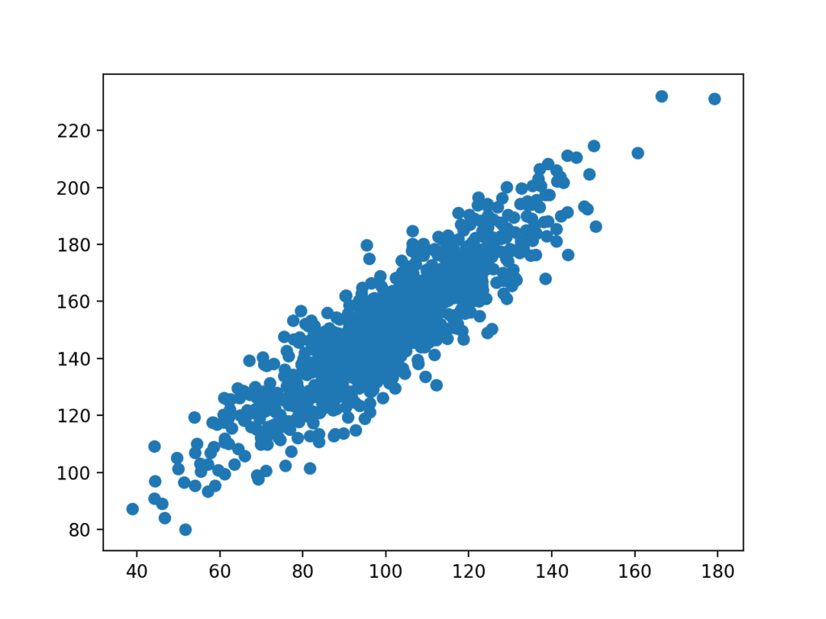
Scatter Plots
Best for showing relationships between variables;
Temperature vs humidity
Humidity vs soil moisture
plt.scatter(temperature, ripening_speed)

Slide 8
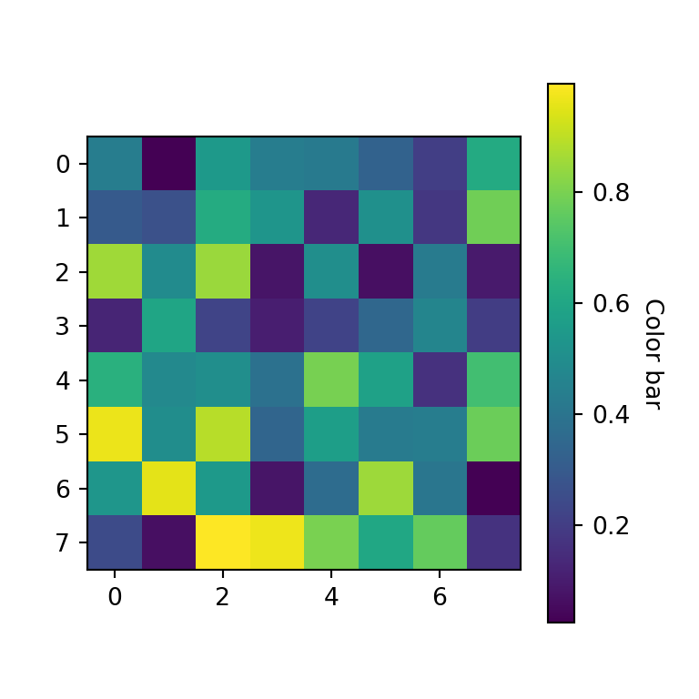
Heat Maps
Use if you want to show correlations or patterns between multiple variables in a matrix form
Example: Correlation between various soil nutrients and crop yield
plt.heatmap(correlation_matrix, annot=True)`

Slide 9
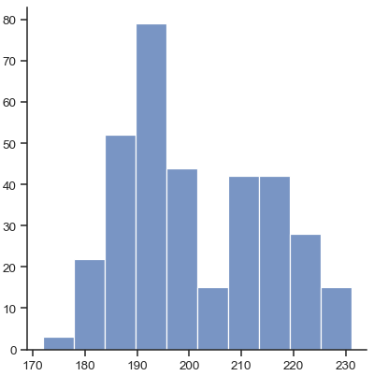
Histograms
Show the distribution of a single variable.
Example: Distribution of noise levels (dB) in a specific region throughout the day
plt.hist(noise_levels, bins=10)`

Slide 10
Python for Visualization

Slide 11
Read & explore the data
import pandas as pd
Df = read_csv(‘data.csv’)
Basic Information: df.info(), df.shape(), df.head()
Check for Missing or Incorrect Data: df.isnull(), df.isna(), df.duplicated()
Handle Missing Data: df.fillna(), df.dropna(), df.replace()
Descriptive Statistics: df.describe(), df.value_counts()

Slide 12


Python Libraries for visualizing Data
Matplotlib: Basic plotting -> good for most basic data visualisation
Seaborn: Statistical visualizations -> builds upon matplotlib, operates on DataFrames, make nice-looking figures easy!
-> look documentation/tutorials/inspiration!

Slide 13
Matplotlib Overview
Matplotlib is a Python library for creating static, animated, and interactive plots
import matplotlib.pyplot as plt
plt.plot([22, 23, 24, 25])
plt.title("Temperature Over Time")
plt.show()

Slide 14
Seaborn Overview
Seaborn builds on Matplotlib and adds beautiful default styles.
import seaborn as sns
sns.scatterplot(x=[22, 23, 24], y=[60, 58, 55])

Slide 15
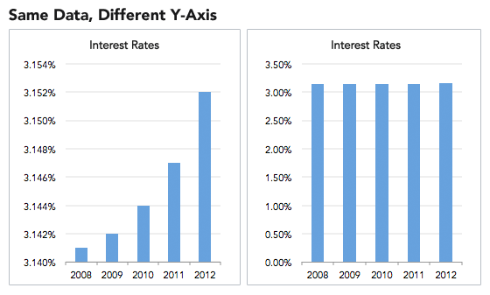
Customizing Graphs
Add titles, labels, colors, and legends
Use plt.title(), plt.xlabel(), plt.ylabel()
Choose colors that are readable
Add gridlines for clarity
Include meaningful labels and units

Slide 16
Saving Graphs as Images
You can save your graphs and include them in reports, presentations or upload them online for sharing.
plt.savefig("temp_plot.png")

Slide 17
Sharing Datasets

Slide 18
Why Share Datasets?
Collaborate with others
Get feedback
Contribute to open science
Build your portfolio

Slide 19

Sharing on Kaggle
Kaggle is a platform for finding, exploring, and sharing quality data and machine learning projects
Create account
Go to Datasets >> New Dataset
Upload CSV and add description
https://www.kaggle.com/

Slide 20

Sharing on GitHub
GitHub is a platform for code and data sharing, great for version control and collaboration
Create repository
Upload CSV and README
Share link with others
https://www.github.com/

Slide 21

Sharing on Google Drive and Sheets
Google Sheets is great for collaboration and sharing, it’s a free and cloud-based option
Upload CSV to Google Drive
Open with Google Sheets
Use Chart Editor to create graphs
Share the google drive link
https://docs.google.com/spreadsheets

Slide 22
Data Ethics
Always consider :
Privacy: avoid personal data
Consent: inform participants
Accuracy: avoid misleading graphs
Attribution: credit sources

Slide 23
Labs

Slide 24
Labs
Make Kaggle Account
Labsheets -> try around with different data visualization techniques
Find Kaggle datasets - come up with descriptive plots for what you want to analyse
What is the research question you want to answer? What do you want to highlight?
Why did you choose the specific plot for this dataset/question? What can you see in the plot?
Notes:
How they gathered data, what type of data, do you understand the complexity…

Slide 25
Example Kaggle datasets you could use
https://www.kaggle.com/datasets/rishidamarla/global-rise-in-temperatures-in-each-country
https://www.kaggle.com/datasets/atharvaingle/crop-recommendation-dataset
https://www.kaggle.com/datasets/anandshaw2001/imdb-movies-and-tv-shows

Slide 26
If you are looking for a slightly easier task
Download this dataset: https://www.kaggle.com/datasets/makuwilad/malawi-tourism-dataset
The ultimate goal is to visualise the amount of hotels in every location (use the lodges.csv)
Make sure to avoid plotting null data (aka exclude nan)
Make sure to combine the similar names, for example 'Mzuzu' appears 65 times, 'Mzuzu.' appears 1 time, and 'Mzuzu City' appears 1 time.
Choose the best plot to visualise it

Slide 27
Wrap-Up & Preview of Day 5
Tomorrow: Electrons for machine learning
Lab: Planning your first ML task and collecting data for training
Great work today! 😎

Slide 28
Timetable | Mon | Tue | Wed | Thu | Fri | Sat | Sun | Mon | Tue | Wed | Thu | Fri
Lecture (1.5 hours) | 11:00am | 10:30am | 10:30am | 10:30am | 10:30am |  |  | 10:30am | 10:30am | 10:30am | 10:30am | 10:30am
Practical (2 hours) | 13:00pm | 13:00pm | 13:00pm | 13:00pm | 13:00pm |  |  | 13:00pm | 13:00pm | 13:00pm | 13:00pm | 13:00pm
Time table

